Slide 1
Benefits of the CTF Program
2014-04-24
(CMC-WG 3)

Slide 2
Definitions:
CTF – Customer's Testing Facility
CBTL – CB Testing Laboratory
NCB – National Certification Body

Slide 3
Customer's Testing Facility Program
Overview:
Testing performed at customer’s facilities by CBTL staff or by customer’s staff under the CBTL’s or NCB’s supervision
Customer testing facilities must comply with relevant aspects of ISO/IEC 17025 and applicable CB Scheme requirements
Validation of customer’s competence is carried out by the CBTL or NCB

Slide 4
Benefits
Allows the use of customer’s specialized test equipment and facilities
Reduces overall product development/approval cycle and time to market
Permits testing at the appropriate time in product development cycle
Reduces approval costs with respect to sample and shipment costs

Slide 5
Benefits (continued)
Takes advantage of customer’s specialized knowledge for test set up and operation of the product under test
Allows the customer to expand knowledge and experience through collaboration with conformity assessment bodies
Permits customer discretion on the level of involvement in the product testing process

Slide 6
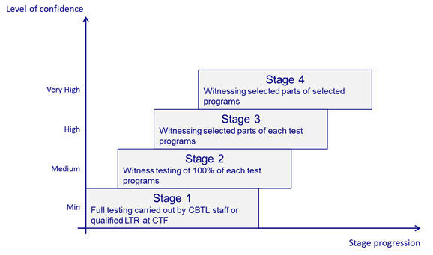
Overview of the CTF Program Stages
Provides a progressive, modular approach to product testing

Slide 7
Facilitates increasing customer involvement in product testing with growing knowledge, experience and capability
Greater knowledge of safety standards translates into safer products
Defines clear criteria for progression through the stages of the program
Provides added transparency and credibility as a third-party conformity assessment program

Slide 8
There are four progressive stages in the CTF program
Stage 1 – Full testing carried out by CBTL staff at CTF
Stage 2 – Witnessing 100 per cent of each test program
Stage 3 – Witnessing selected parts of each test program.
Stage 4 – Witnessing selected parts of selected test programs
Notes:
Stages 3 and 4 require participation in the IECEE Proficiency Testing Program
Stage 4 additionally involves IECEE Assessment initially and every three years

Slide 9
IECEE: taking Conformity Assessment further Thank you!

