Slide 1
IECEE and CB Scheme
Presenter name
Title
Date

Slide 2
History of the IECEE
The IECEE System, originally operated by the CEE (International (European) Commission for Conformity Certification of Electrical Equipment), was integrated into the IEC in 1985 as the CB Scheme of the IECEE.
Today the IECEE System helps Industry to access the Global Market for Electrotechnical Equipment and Components
IEC
CEE

Slide 3
Conformity Assessment
What is Conformity Assessment ?
Demonstration that specified requirements (IEC International Standards) relating to a product, process, system, person or body are fulfilled
Testing, inspection and certification are part of the concept of Conformity Assessment either as a stand alone activity or all together.

Slide 4
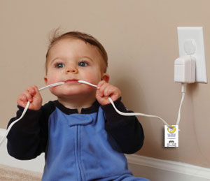
IEC conformity assessment is not left to amateurs

Slide 5
Conformity Assessment
IECEE is operating a 3rd Party conformity assessment scheme
3rd party conformity assessment activity is performed by a person or body that is independent from the person or organization that provides the product, and of users of that product.
  Criteria for the independence of conformity assessment bodies and accreditation bodies are provided in the International Standards and Guides applicable to their activities

Slide 6
Conformity Assessment under IECEE Scheme
Products are tested to IEC International Standards with provision for supplementary testing for national differences, when relevant.
Reciprocal recognition of test results among all participating Certification Bodies simplifies the granting of certification or approval at national levels.
CB Test Certificates and associated Test Reports facilitate obtaining secondary certifications.

Slide 7
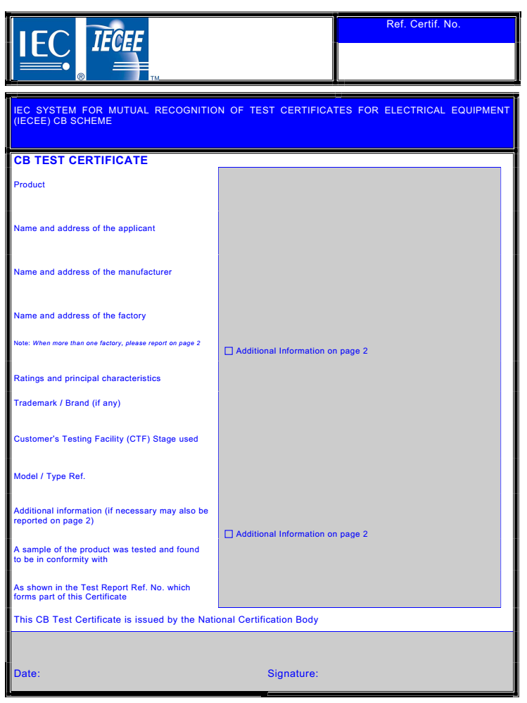
Mutual Recognition
Manufacturer / supplier
NCB “A’’
CBTL
Apply national differences
Product sample + countries list
Testing
CB Test Certificate + Test Report
Test Report
Country X
NCB ‘’B’’ →National Mark
Country Y
NCB ‘’C” →National Mark
Country Z
NCB ‘’D’’ →National Mark

Slide 8
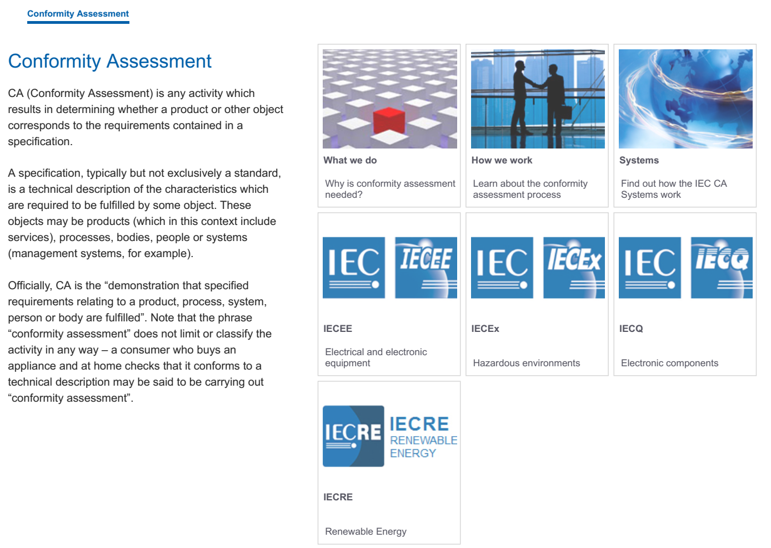
The IEC CA Systems

Slide 9
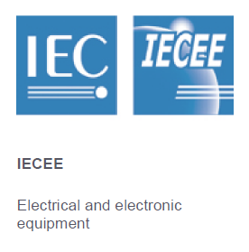
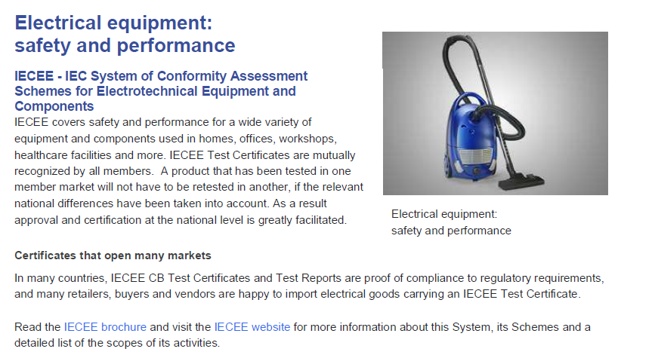
The IECE CA Systems

Slide 10
Tailor Made for the Customer
…Performance requirements
…Regulatory requirements
Safety Requirements plus…
… EMC requirements
…Ergonomic, Hygienic requirements

Slide 11
Tailor Made for the Customer
Because Globalization and competition are leading to
rapid changes, technical barriers to trade remain a
serious problem and the industry is anxious about
time to market, the shortening life cycle of products
and the need to reduce costs…
The CB Scheme offers de facto the true “passport” for
the needs of different countries.
The CB Scheme answers de facto the market needs
to have a Test Certificate tailored to be recognized
worldwide.
The CB Scheme, in its fullest extent, proves de facto
that certification and testing costs can be reduced
through the use of... one stop testing.

Slide 12
IECEE CB Scheme

Slide 13
IECEE CB Scheme
  The IEC System of Conformity Assessment Schemes for Electrotechnical Equipment and Components (IECEE) operates a scheme with the aim of facilitating international trade by promoting and simplifying certification and approval at national level through mutual recognition of test results.
  CB Test Certificates … are used as the means for mutual recognition of test results.

Slide 14
IECEE CB Scheme
  The Scheme is called
  “IECEE CB Scheme for Mutual Recognition of Test Certificates for Electrotechnical Equipment and Components”
  hereinafter referred to as the
  “CB Scheme”

Slide 15
IECEE Conformity Assessment Schemes
  The IECEE Schemes are based on the principle of mutual recognition (reciprocal acceptance) by its worldwide members of test results for obtaining certification or approval at national level.
  The IECEE Schemes in the last decade have naturally evolved and become « de facto » the most accepted proof of compliance by many countries’ authorities and regulators as the passport to enter their markets without further testing.

Slide 16
Aim (1)
  The aim of the CB Scheme is
  to provide manufacturers
  seeking worldwide third party certification marks,
  the most economic and cost effective procedures
  within the best certification time frame.

Slide 17
Aim (2)
  The CB Scheme is based on the use of CB Test Certificates which provide evidence that representative specimens of the product have successfully passed tests to show compliance with the requirements of the relevant IEC International Standard.
  A supplementary report providing evidence of compliance with declared national differences in order to obtain national certification or approval may also be attached to the CB Test Report.

Slide 18
CB Scheme Highlights
Reciprocal recognition of test results among all participating Certification Bodies, to simplify granting of certification or approval at national levels.
CB Test Certificates and associated Test Reports facilitates obtaining secondary certifications.
The CB Scheme is the only internationally recognized scheme for the safety of electrical equipment used in homes, offices, workshops and similar locations.
Products are tested to IEC International Standards with provision for supplementary testing for national differences.

Slide 19
CB Scheme Advantages
More rapid testing and certification
More universal product recognition
Acceleration of product acceptance
Direct acceptance by the authorities in many countries
Direct acceptance by the retailers and buyers
Expanded markets
Faster product movement from plants to markets

Slide 20

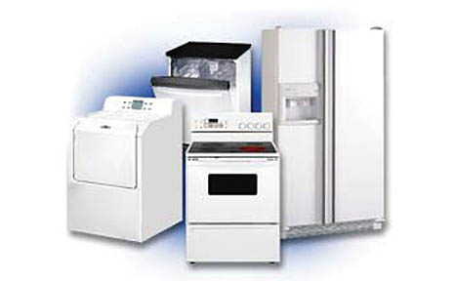
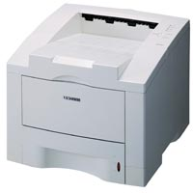


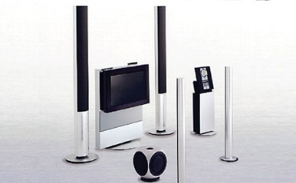
CB Scheme Operations (1)
23 product categories ranging from Information Technology and electronic equipment, household, medical equipment, lighting to EMC, and Photovoltaics but 60% of activity is concentrated in these three areas:
  Household appliances
  Office & IT equipment
  Electronics / entertainment

Slide 21

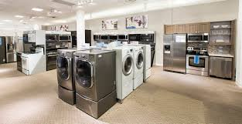
CB Scheme Operations (2)
Time to Market
is essential
In manufacturing and trade everyday counts
Buyers, users and governments need assurance of compliance

Slide 22











CB Scheme Benefits
Leads to safer products on domestic market
Needs to become even more efficient to provide fast time-to-market to suppliers
and will make the world’s products available to your domestic professional buyer and consumer

Slide 23
CB Scheme
  The operating units of the Scheme are the NCBs accepted according to these Rules.
  Those NCBs employ testing laboratories also accepted according to the Rules, known as CB Testing Laboratories (CBTLs).
  A list of NCBs and CBTLs is published on the IECEE website

Slide 24
CB Scheme
  The first step for an NCB, intending to operate in the CB Scheme, is to be accepted as a Recognizing NCB.
  Such an NCB is prepared to recognize CB Test Certificates as a basis for certification or approval at national level for one or more categories of products

Slide 25
CB Scheme
  The second step for an NCB, which can be taken at the same time as the first step, is to be accepted as an Issuing and Recognizing NCB.
  Such an NCB is entitled to issue CB Test Certificates for the categories of equipment for which it recognizes CB Test Certificates.

Slide 26
IECEE Facts
54 participating countries
92 National Certification Bodies - NCBs
About 550 Testing Laboratories – CBTLs
More than 127.000 certificates issued in 2021
More than 15.000 manufacturers using the CB Scheme, more than 2000 registered in the CTF programs

Slide 27
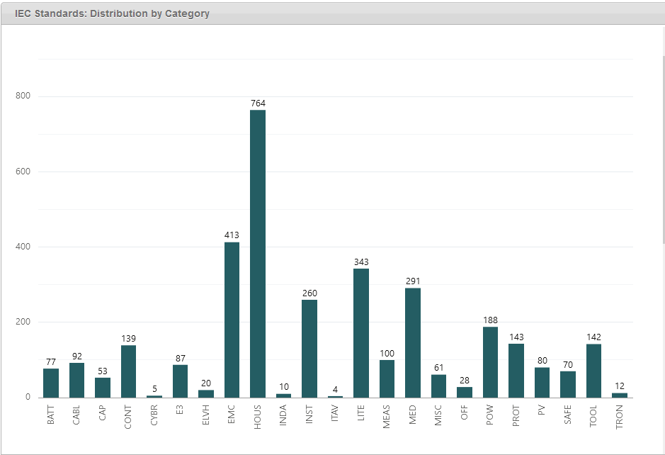
IECEE 23 Categories of Products

Slide 28
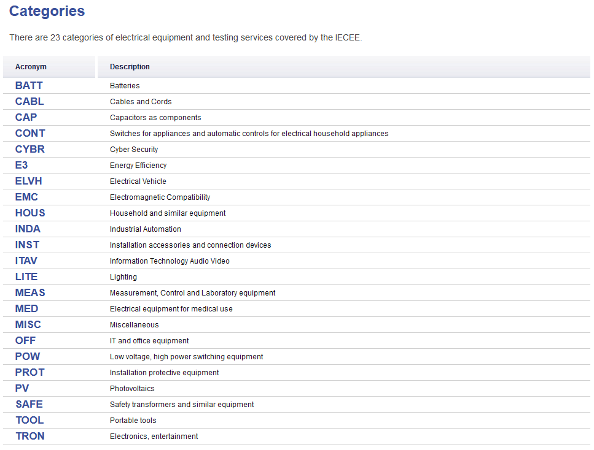
IECEE 23 Categories of Products

Slide 29
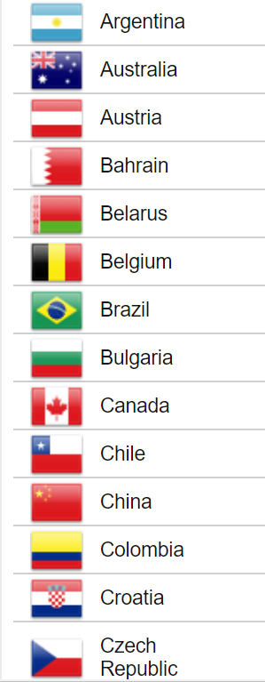
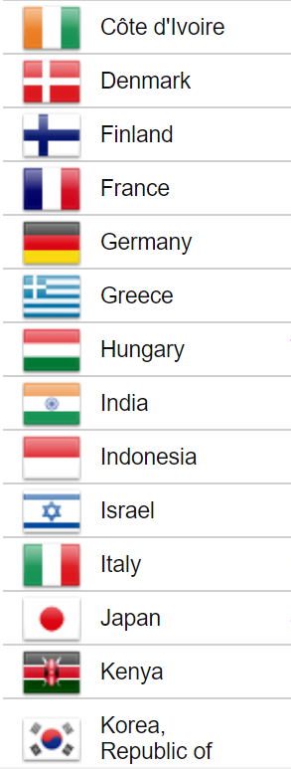
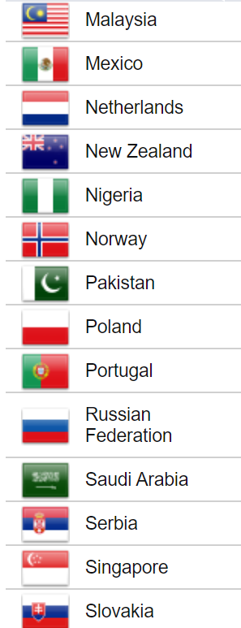
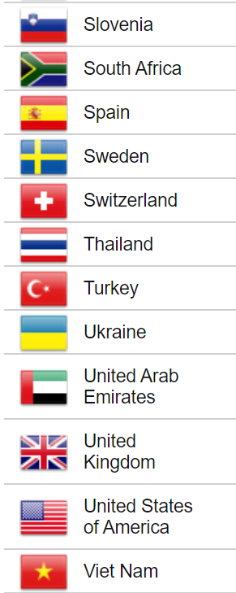
54 Participating Countries

Slide 30
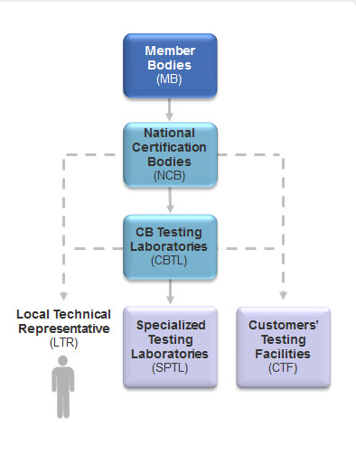
Operation
NCB
CBTL
SPTL
CTF
LTR
Process
  Issuing
  Recognizing

Slide 31
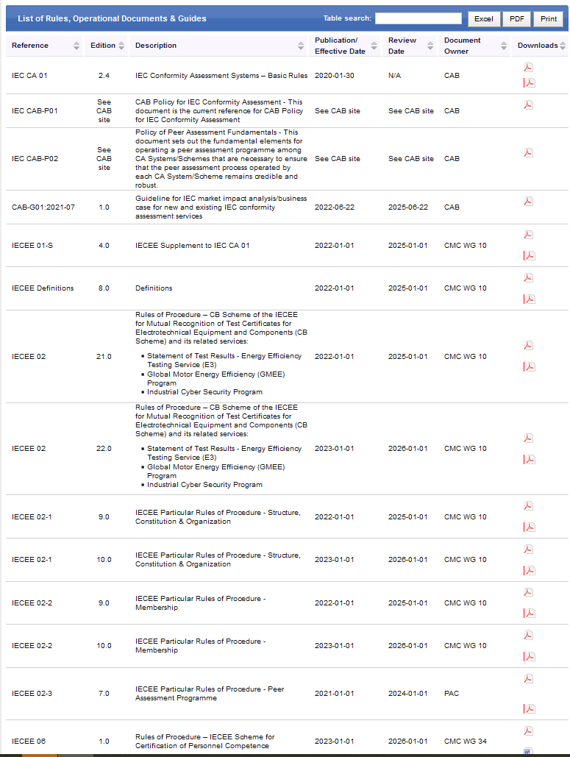
Framework

Slide 32
Application Process
An application for the acceptance of a laboratory as a CBTL for testing of products according to one or more IECEE accepted standards and are in the scope of the Issuing and Recognizing NCB of the candidate laboratory, shall be made by the NCB, via the Member Body of the IECEE for that NCB.
The application shall be submitted to the Secretary of the IECEE and shall be accompanied by the relevant documentation as detailed in OD-2007.

Slide 33

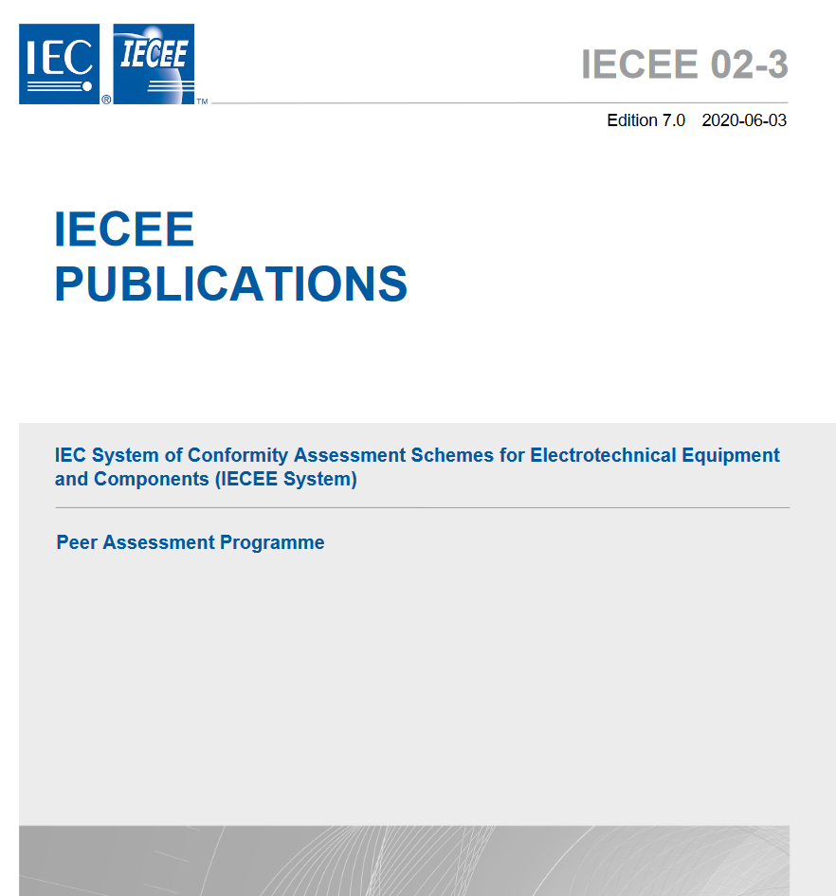
Peer Assessment
The candidate CB Testing Laboratory shall be assessed according to the Rules of IECEE 02-3.

Slide 34

Peer Assessment Process
ASSESSMENT REPORT(s)
Testing Laboratory
CBTL
ASSESSMENT TEAM
ON-SITE ASSESSMENT ISO/IEC 17025
ODs
DECISION
PAC
CMC
RECOMMENDATION

Slide 35
Peer Assessment (1)
Well-founded “Mutual Confidence” is needed for NCBs to grant their Certification Mark on the basis of the review of Test Results without repeat testing; this is what Peer Assessments achieve.
Administered Globally by the IECEE Secretariat in Geneva using a registered pool of International Lead Assessors and Technical Assessors located around the world nominated by most of the 54 active member countries

Slide 36
Peer Assessment (2)
The assessments are conducted by QMS and Technical Experts, employed by the Member Organisations of the IECEE, which ensure Members’ Certification Bodies and Testing Laboratories are competent to conduct Conformity Assessment activities against:
ISO/IEC 17065 and;
ISO/IEC 17025

Slide 37
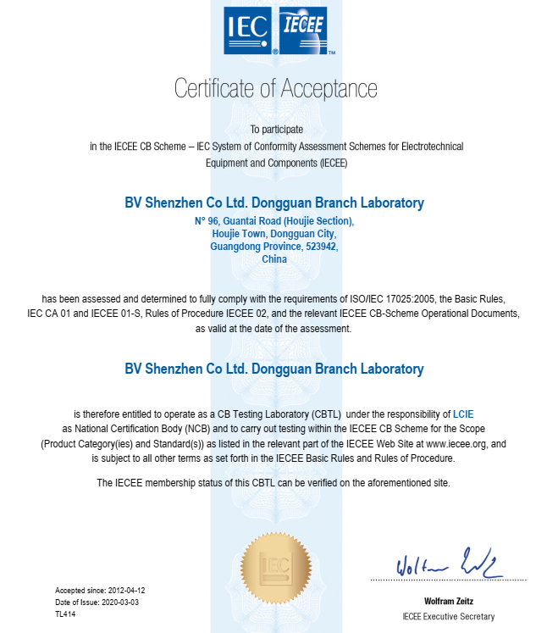

Slide 38
Suspension
The acceptance of a CBTL may be suspended or withdrawn by the CMC, on recommendation of the Secretary of the IECEE, if the laboratory no longer fulfils the conditions of IECEE 02-2. Before such a recommendation is made, the laboratory and the NCB involved shall have the opportunity to take corrective action over a period of six months and state their own opinion on the matter.

Slide 39
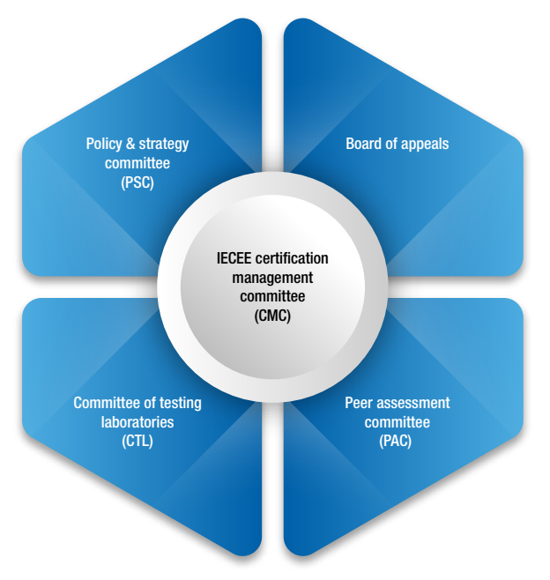
IECEE Structure
PSC
Policy and Strategy Committee
Board of Appeal

Slide 40
IECEE CMC Composition (1)
a) delegation of up to three persons from each Member Body. The delegation shall take account of all interests in the conformity assessment process at national level, including those of regulatory authorities, equipment users, manufacturers, service providers and conformity assessment bodies
In the delegation, at least one person shall represent the interests of an NCB or NCBs and at least one person should represent (manufacturing) industry interests. Additional NCBs not represented on the official delegation of a member body may attend as “Other NCB Representatives”
Other NCB Representatives to be limited to one representative per Other NCB, and any additional participants to be treated as Observers.
Composition per IEC CA 01 and IECEE 01-S

Slide 41
IECEE CMC Composition (2)
b) the Chair (without vote)
c) the immediate past Chair (without vote)
d) the Vice-Chair (without vote)
e) the Treasurer (without vote)
f) the Executive Secretary (without vote)
g) the Chair and Secretaries of Committees and Convenors of other Groups established by the CMC (without vote)
h) the Chair of the CAB (ex-officio without vote)
i) the IEC General Secretary & CEO (ex-officio without vote).
Composition per IEC CA 01 and IECEE 01-S

Slide 42
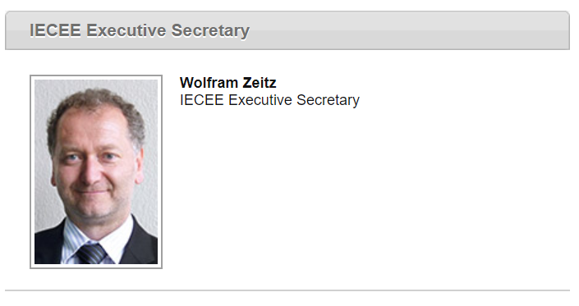
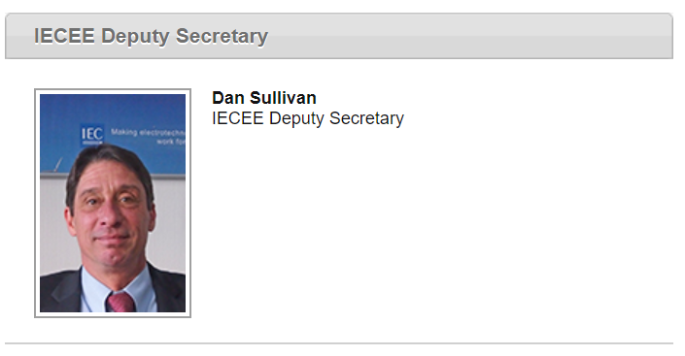
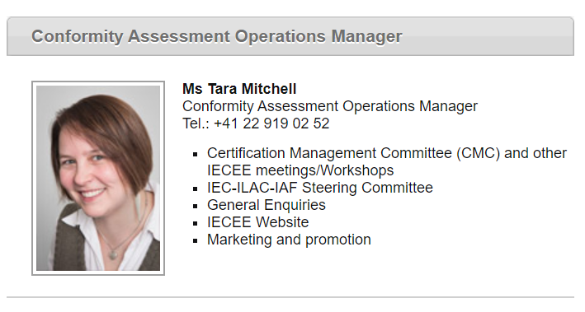
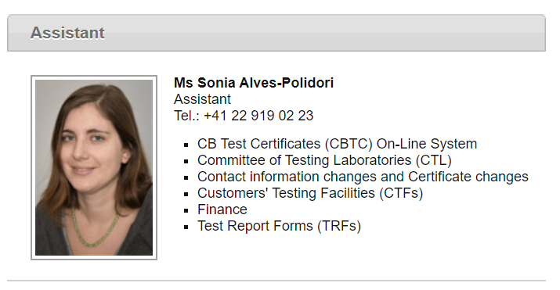
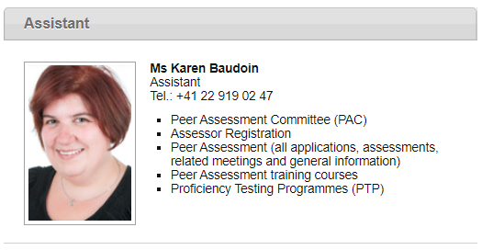
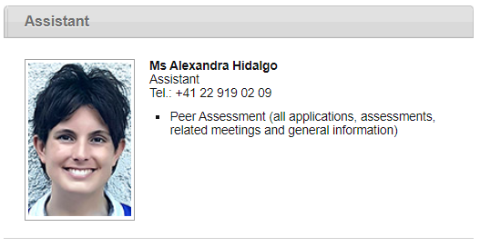
IECEE Secretariat – Geneva (1)

Slide 43
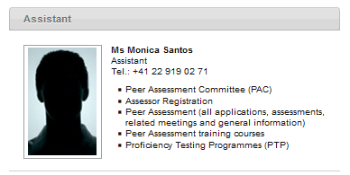
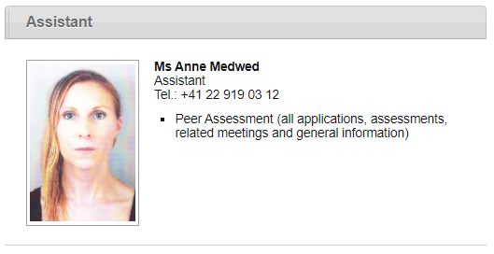
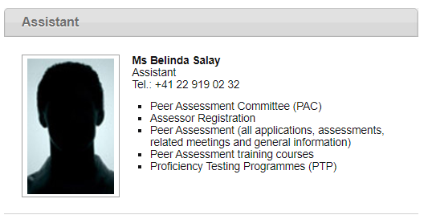
IECEE Secretariat – Geneva (2)

Slide 44
IECEE Officers (1)
The officers of the IECEE are:
• Chair,
• Vice-Chair,
• Treasurer, and
• Executive Secretary
The Chair or the Vice-Chair shall represent the interests of the IECEE System.
The position of Chair and Vice-Chair should ideally rotate between Industry and Conformity Assessment representatives.

Slide 45
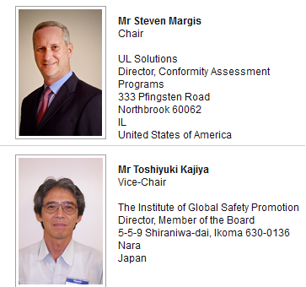
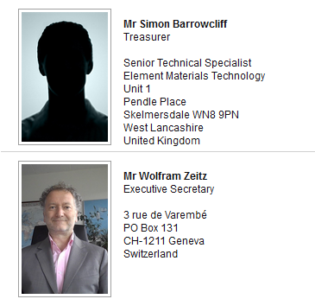
IECEE Officers (2)

Slide 46
IECEE Officers: Chair
The Chair is appointed for a period of three years by the CAB, on the nomination of the CMC. The Chair is eligible for re-appointment in the same office for one further period of three years. If at the conclusion of a second or subsequent term there are no new candidates nominated for election to the position, the CMC may by specific resolution, outlining the circumstances, propose to the CAB that the incumbent Chair be appointed to one additional year in that position.
The Chair shall not, upon appointment, act as a national delegate to the CMC.

Slide 47
IECEE Officers: Vice-Chair
The Vice-Chair is appointed for a period of three years by the CAB, on the nomination of the CMC. The Vice-Chair is eligible for re-appointment in the same office for one further period of three years. If at the conclusion of a second or subsequent term there are no new candidates nominated for election to the position, the CMC may by specific resolution, outlining the circumstances, propose to the CAB that the incumbent Vice-Chair be appointed to one additional year in that position.
The Vice-Chair may at the same time be a national delegate to the MC, except when they take the chair at a meeting.

Slide 48
IECEE Officers: Treasurer
The Treasurer is appointed for a period of three years by the CAB, on the nomination of the CMC. The Treasurer is eligible for re-appointment in the same office for one further period of three years. If at the conclusion of a second or subsequent term there are no new candidates nominated for election to the position, the CMC may by specific resolution, outlining the circumstances, propose to the CAB that the incumbent Treasurer be appointed to one additional year in that position.
The Treasurer may at the same time be a national delegate to the CMC.

Slide 49
IECEE Officers: Executive Secretary
The Executive Secretary is appointed for a period of five years by the CAB, upon nomination by the CMC and is eligible for re-appointment without restriction. The Executive
Secretary is an employee of the IEC and a decision to appoint the Executive Secretary requires prior consent of the IEC General Secretary & CEO. The IECEE Chair shall consult with CAB Chair and the IEC General Secretary & CEO before a proposal is made to the CMC for a nomination of an Executive Secretary.
The Executive Secretary shall act independently of any Member of the IEC CA System and shall not act as a national delegate to the CMC.

Slide 50
PSC - Policy and Strategy Committee (1)
Identifying market needs …
Proposing targets of particular countries and/or services …
Proposing mechanisms for ensuring that the IECEE Conformity Assessment solutions are recognized …
Developing proposals for new programs and services …
Providing to the CMC the PSC interpretation of the relevant CAB policies, directions and decisions.
Designing a framework or road map for the development of conformity assessment solutions …

Slide 51
PSC - Policy and Strategy Committee (2)
Providing strategic recommendations to the CMC in the area of standards (IEC and other standards) used for conformity assessment, their acceptance around the world, and regulatory requirements.
Providing to the CMC guidance and direction on matters such as …
o IEC Masterplan …
o Trade and regulatory trends …
o Relationships with outside organizations…
o New accreditation requirements…
  o Potential new IECEE structures and links …
  o New alliances …

Slide 52
CTL - Committee of Testing Laboratories (1)
The main tasks of the CTL are to:
detail the way in which the tests related to the IECEE have to be carried out so as to achieve the necessary reproducibility of test results,
harmonize the design and use of the test equipment referred to in standards and to make recommendations to the relevant technical committee or subcommittee of the IEC for improvements of those standards,
provide testing laboratories with a forum in which practical testing problems can be demonstrated and discussed

Slide 53
CTL - Committee of Testing Laboratories (2)
The task of the CTL is to:
Organize Proficiency Testing Programmes under the auspices of the IECEE CMC
Organize Workshops to analyze the results of PT programmes and subsequent test methodology to achieve consistent test results
Carry out other technical work as directed by the CMC.

Slide 54
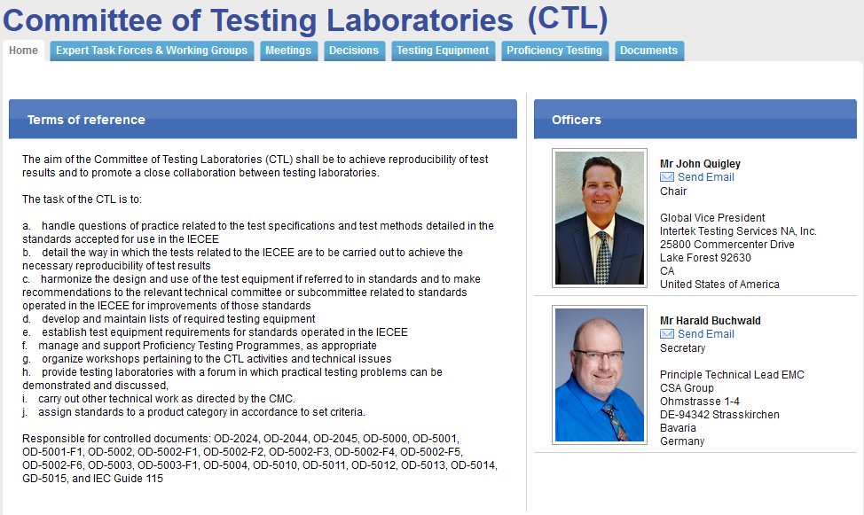
CTL - Committee of Testing Laboratories (3)

Slide 55
CTL - Committee of Testing Laboratories (4)
ETF 01 "HOUS, TOOL, TOYS"
ETF 09 "Photovoltaics"
ETF 02 "TRON, OFF, ITAV"
ETF 15 "High/medium voltage components coordination"
ETF 10
“EMC"
CTL
ETF 07 "POW, PROT, GMEE"
ETF 03 "MEAS, MED"
ETF 16
"Cyber Security"
ETF 11 “Laser"
ETF 06 "CABL"
ETF 04
"INST, CONT, CAP, MISC"
ETF 05 "LITE, SAFE"
ETF 14 "EMobility"
ETF 13 “BATT"

Slide 56
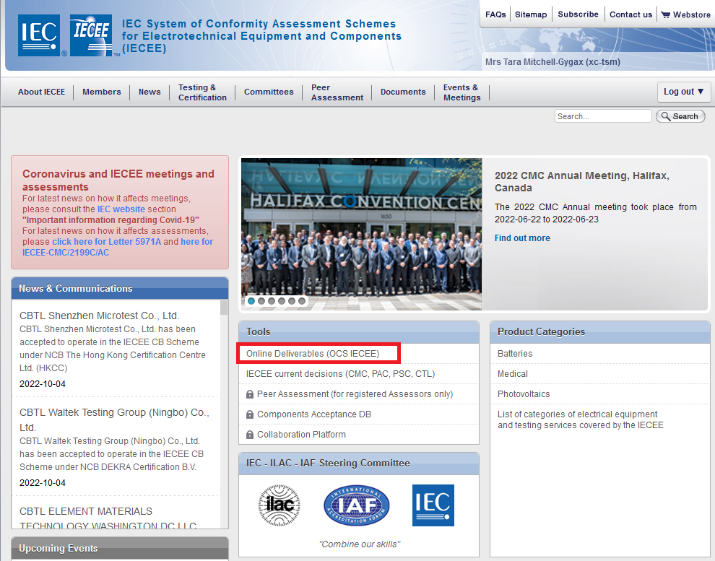
How to Search Certificates (1)

Slide 57
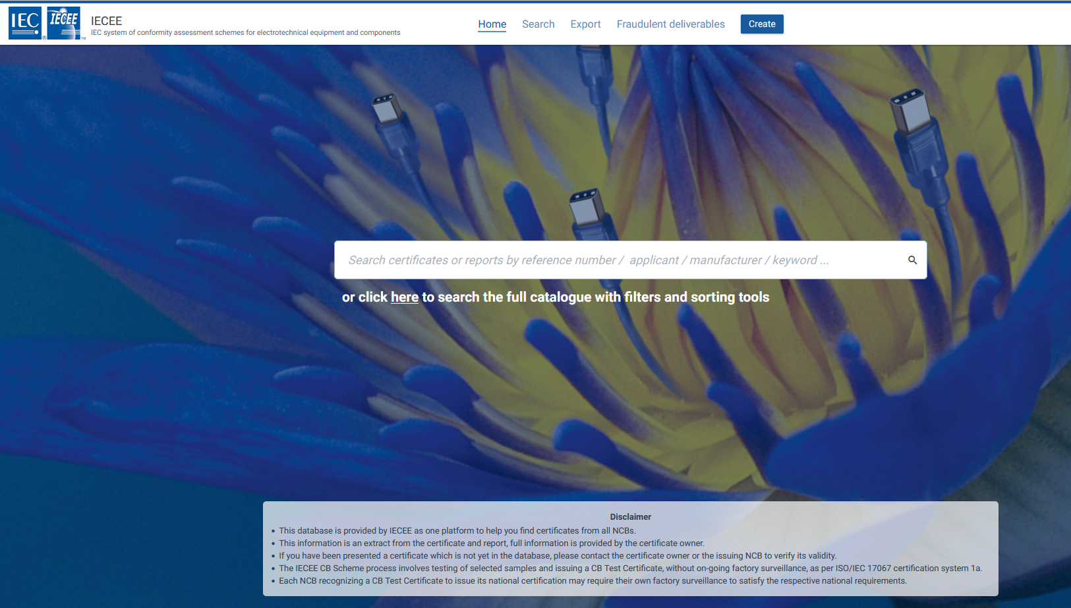
How to Search Certificates (2)

Slide 58
Rules and Procedures
Website (www.iecee.org)
  Where to find what
  Where to find current decisions

Slide 59
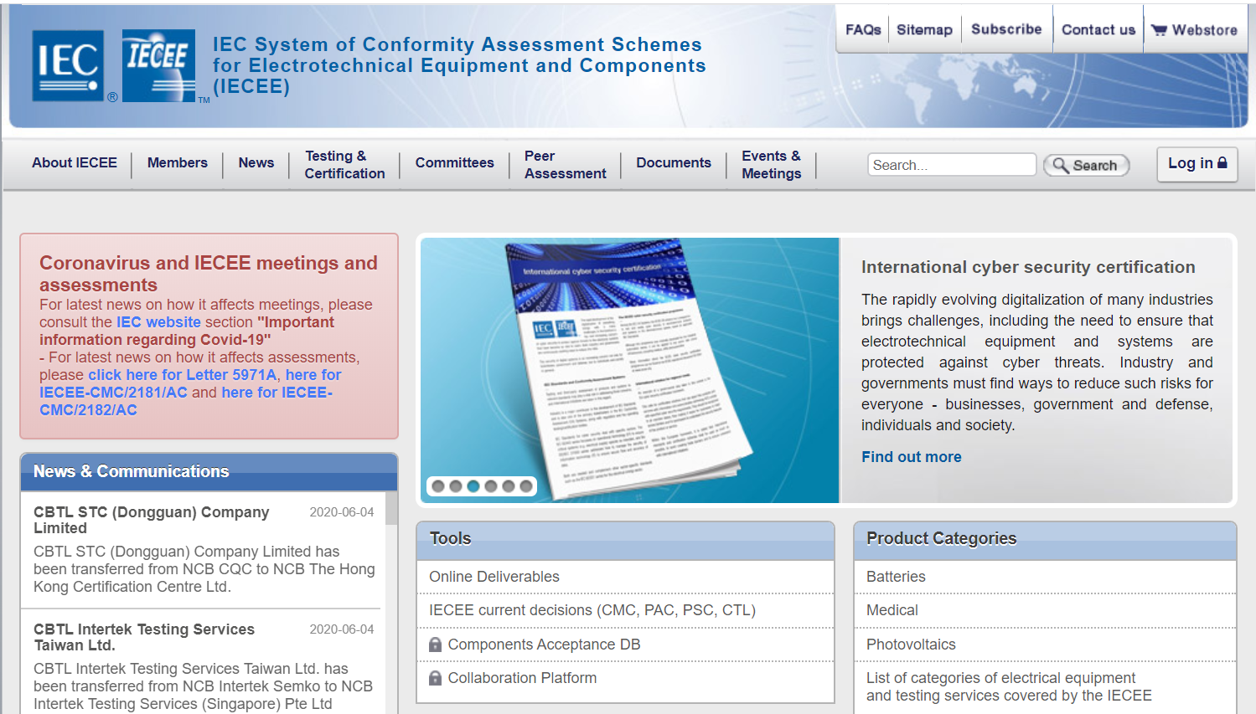
IECEE CB Scheme Decisions (1)
Current Decisions

Slide 60
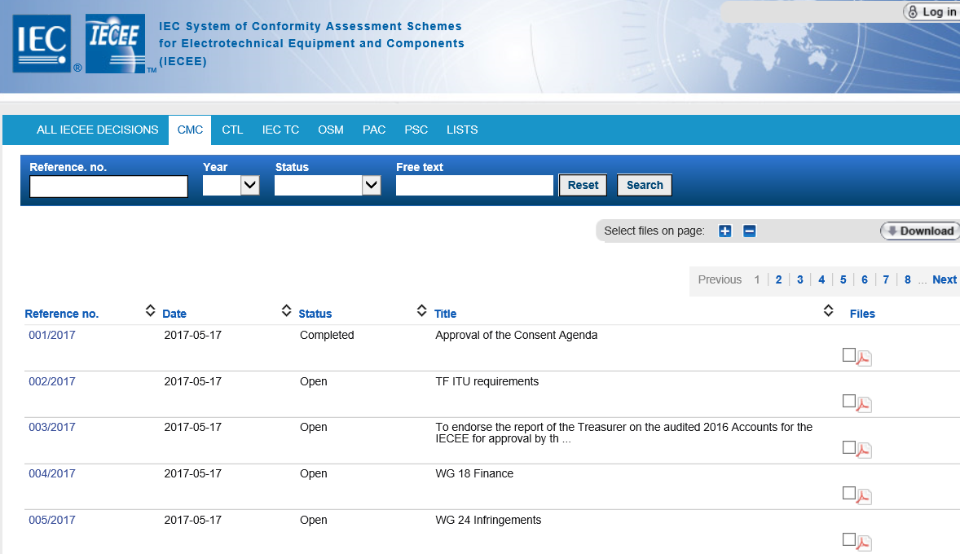
IECEE CB Scheme Decisions (2)

Slide 61
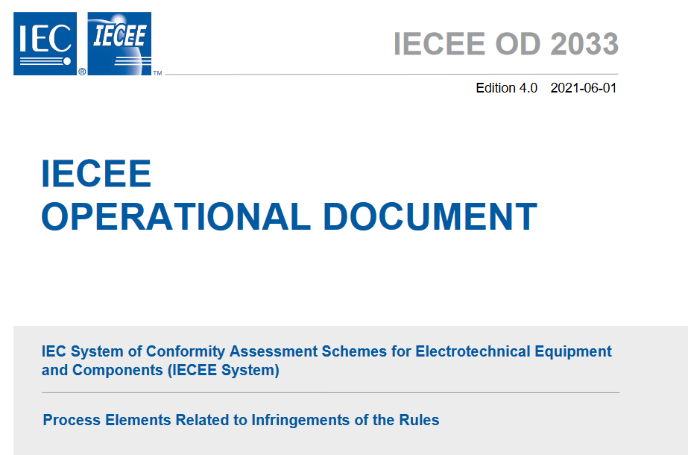
Rules and Procedures(1)

Slide 62
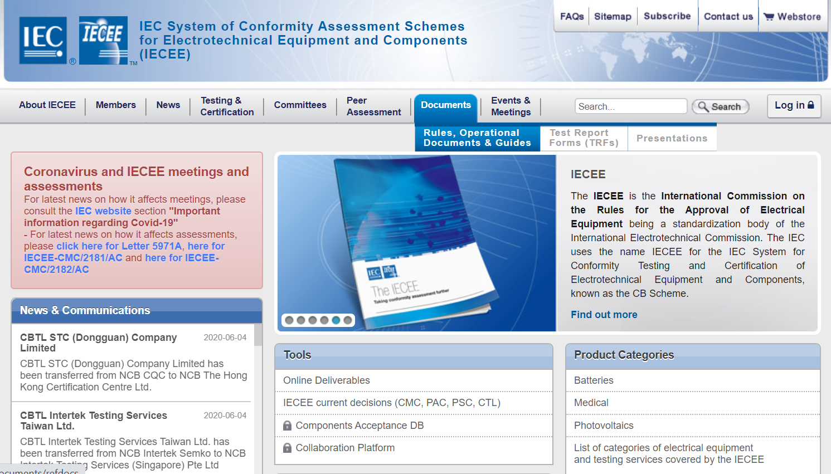
Rules and Procedures(2)
Rules & Procedures

Slide 63
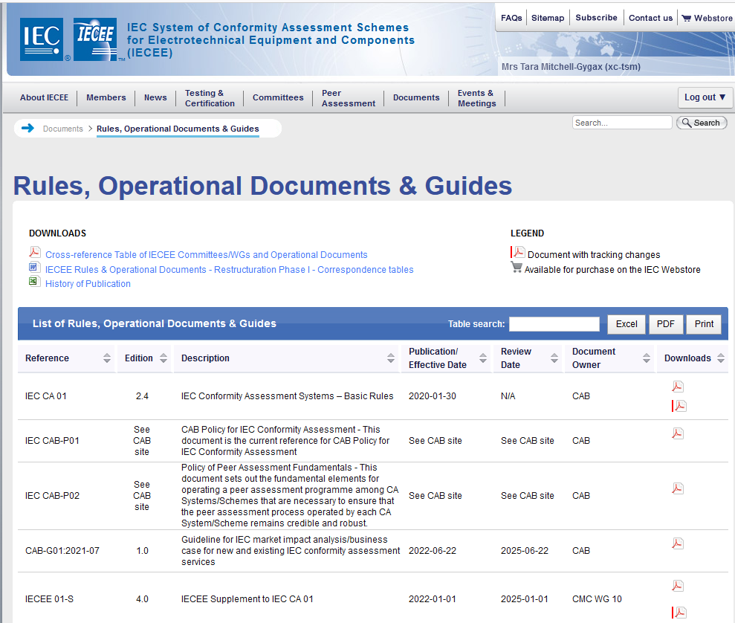
Rules and Procedures(3)

Slide 64
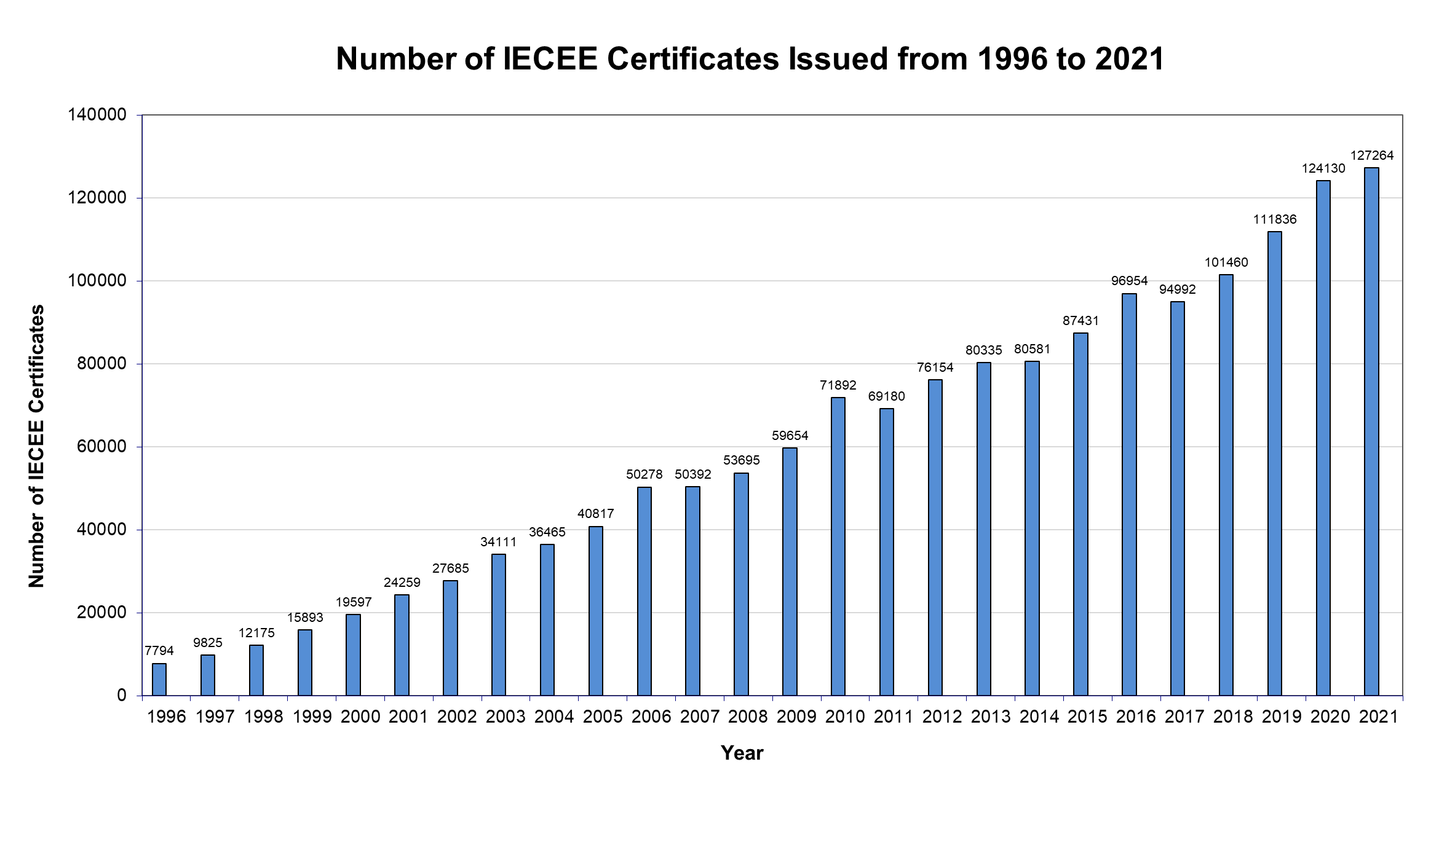
Statistics

Slide 65
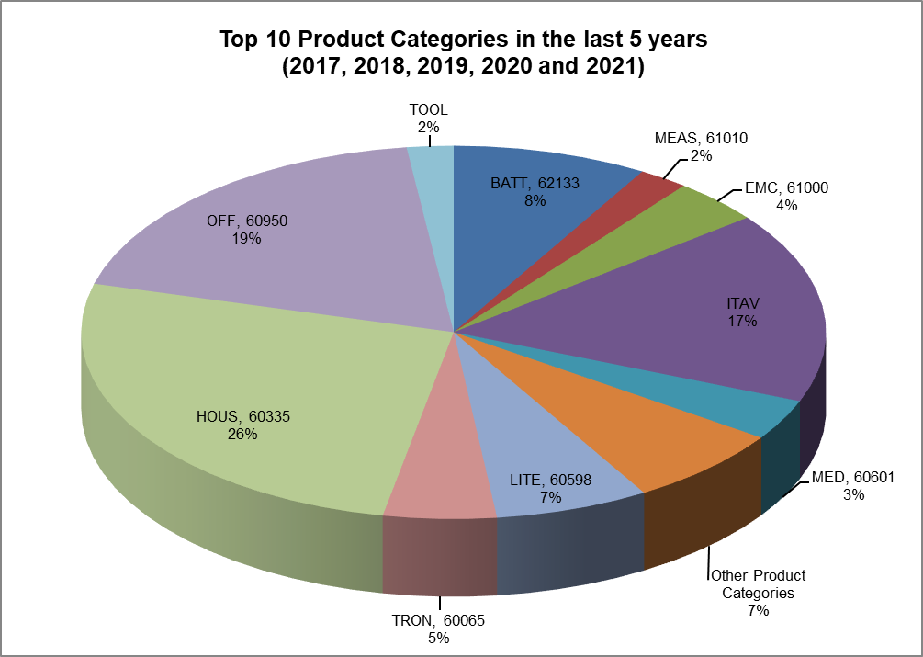
Statistics

Slide 66
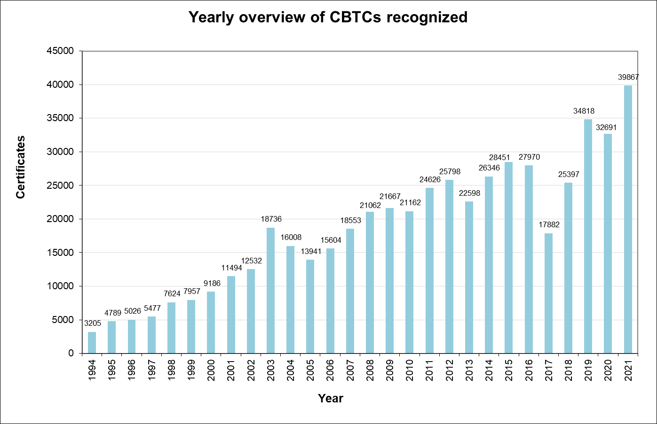
Statistics

Slide 67
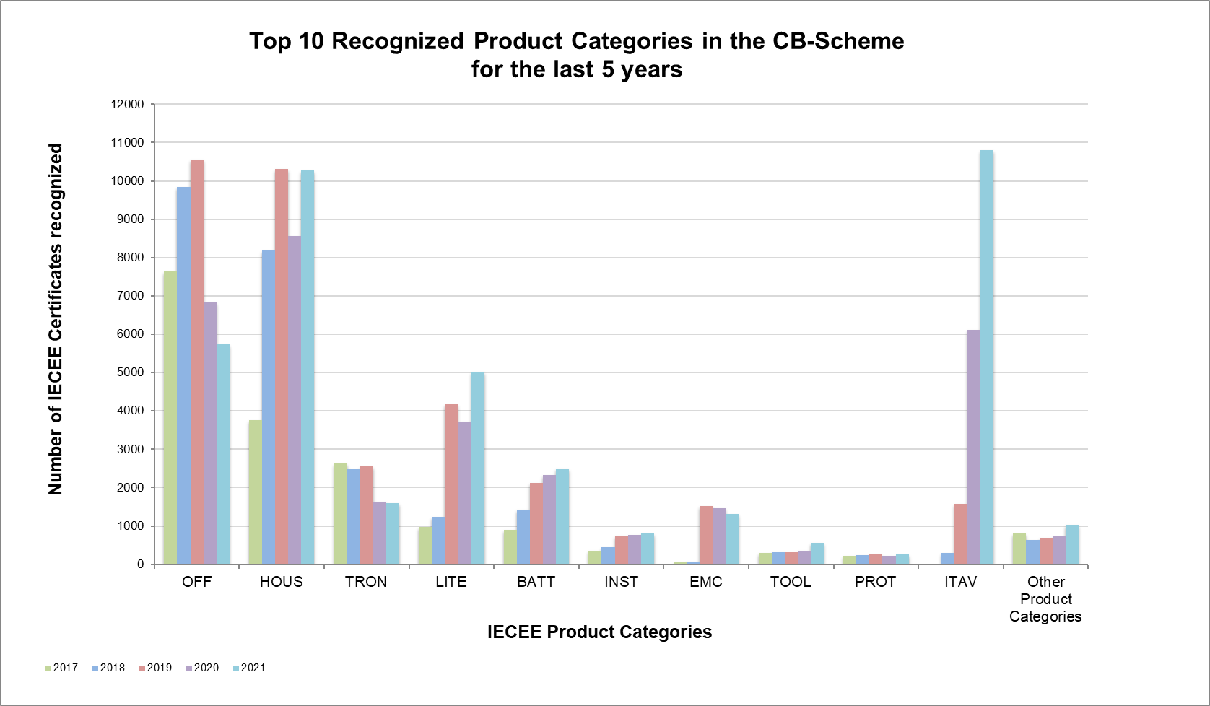
Statistics

Slide 68
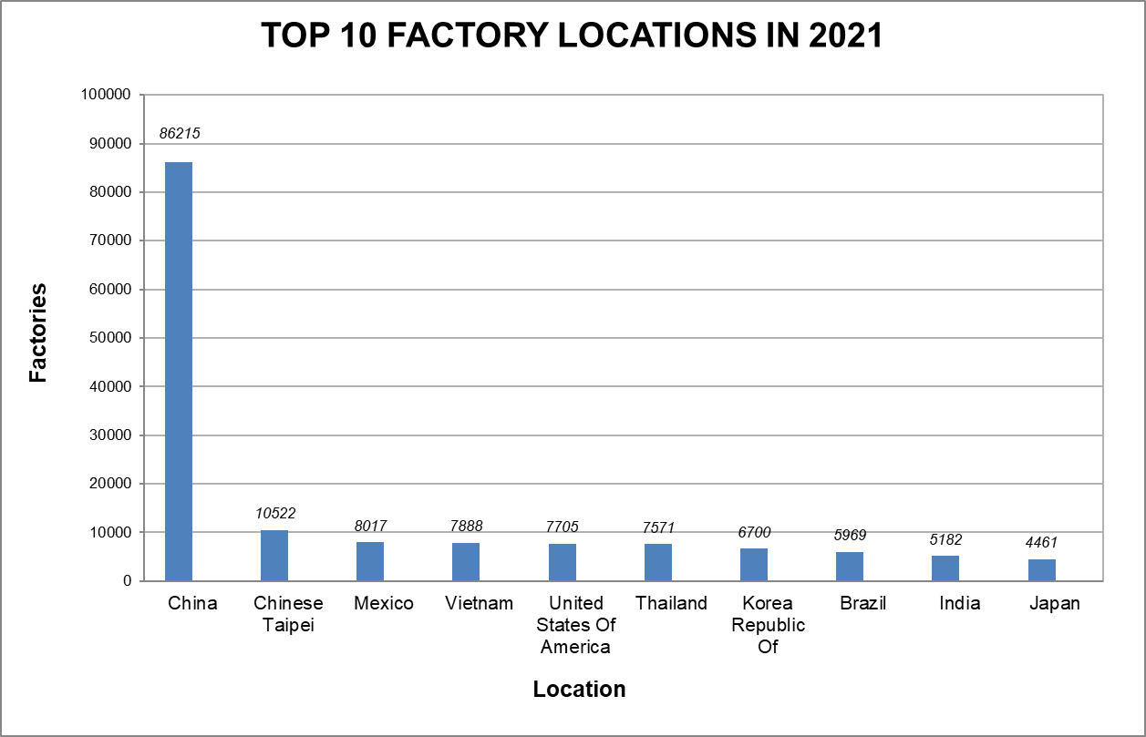
Statistics

Slide 69
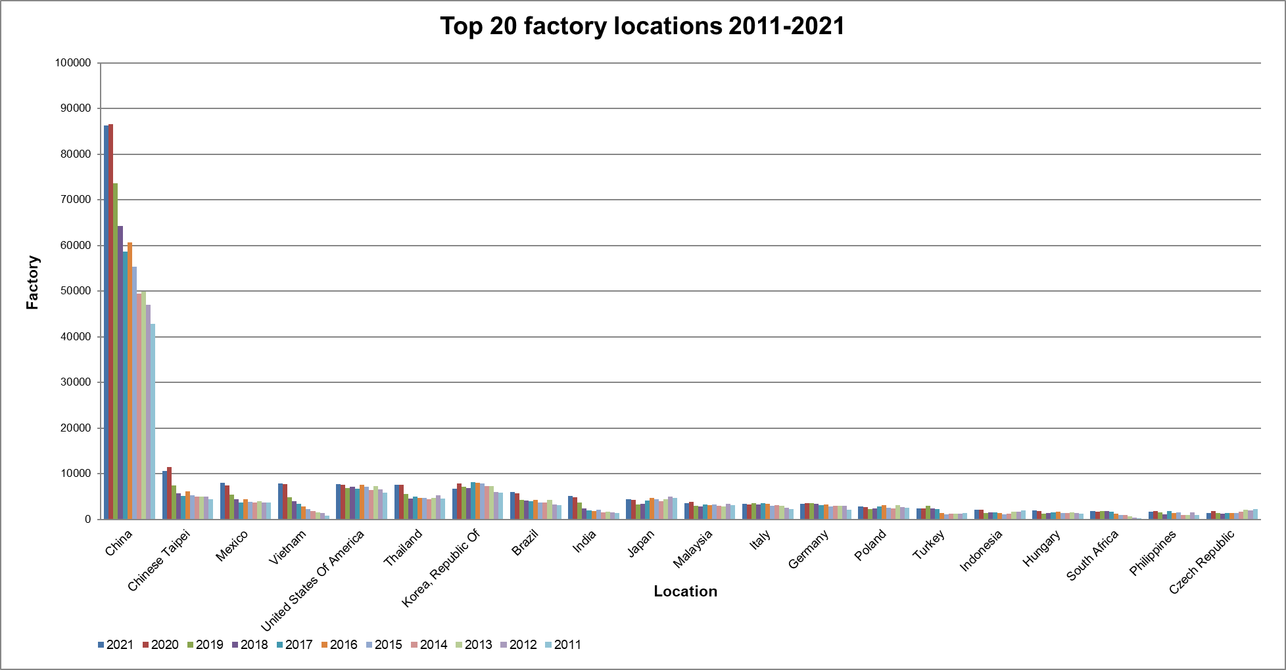
Statistics

Slide 70
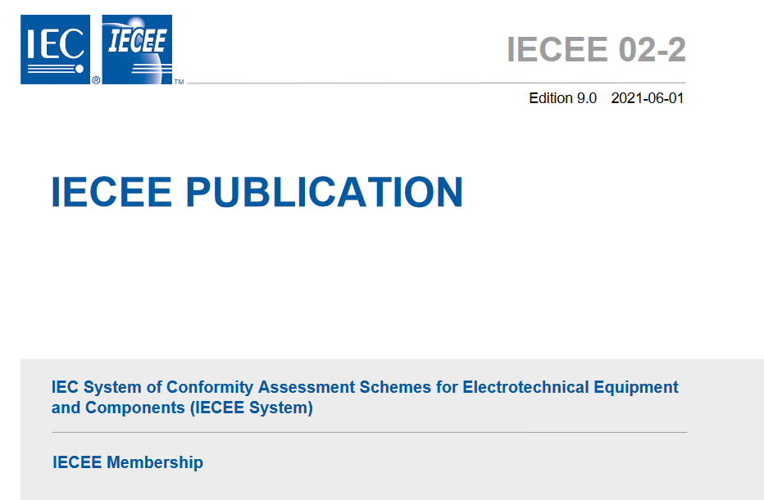
Membership
Application
  Documents
  Time Frame
Peer Assessment
  Initial
  Re-Assessment
  Follow up Assessment
  Re-Location
Acceptance
Suspension

Slide 71
Development and Outlook
New Services
Co-operations

Slide 72
Development and Outlook
Task Force Radio – Currently investigating if there is a feasible business case for IECEE to develop a conformity assessment service in the radio sector
Certification of Personnel Competence - Develop a relevant solution for Certification of Personnel Competence in the IECEE
Services for IEC/IEEE 60802 – Develop a unique approach for conformity assessment for IEC/IEEE 60802 “Time Sensitive Network profile for industrial automation”

Slide 73

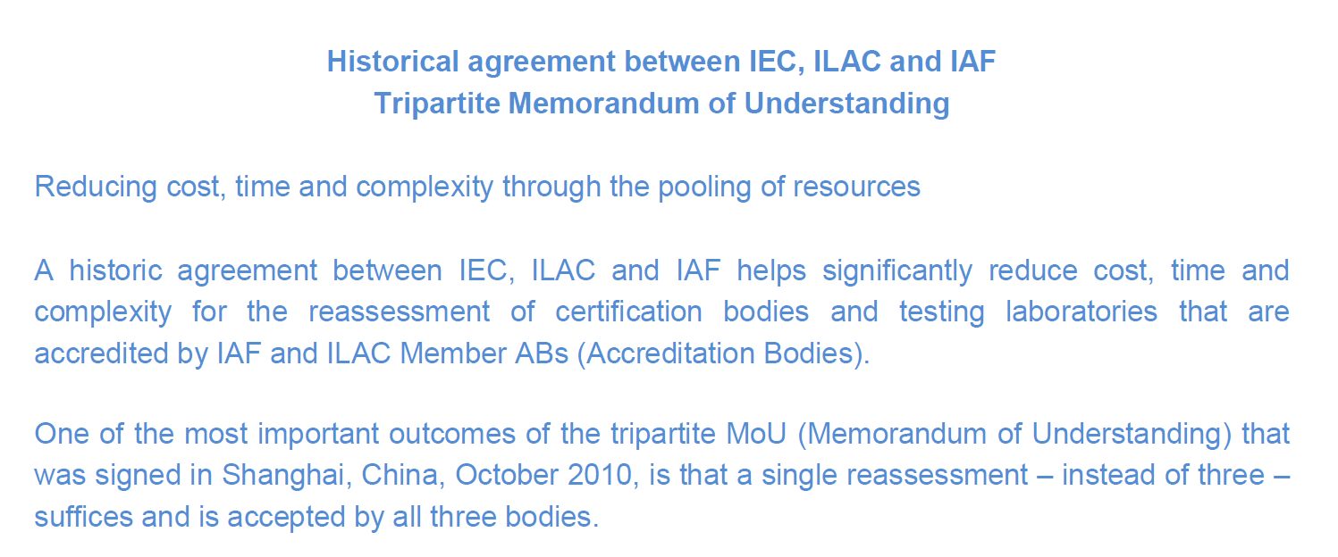
Development and Outlook

Slide 74

Today’s IECEE achieved target
One test
One international certificate
One or more marks as needed

Slide 75
Thank you

